Slide 1
Risk Management
Introduction
Risk identification
Risk projection (estimation)
Risk mitigation, monitoring, and
management
(Source: Pressman, R. Software Engineering: A Practitioner’s Approach. McGraw-Hill, 2005)

Slide 2
Project Risks
What can go wrong?
What is the likelihood?
What will the damage be?
What can we do about it?

Slide 3
Introduction

Slide 4
What Is Software Risk?
Risk is an expectation of loss, a potential problem that may or may not occur in the future.
It is generally caused due to lack of information, control or time.
A possibility of suffering from loss in software development process is called a software risk.
Loss can be anything, increase in production cost, development of poor quality software, not being able to complete the project on time.

Slide 5
Types of software risks
Software risk exists because the future is uncertain and there are many known and unknown things that cannot be incorporated in the project plan.
A software risk can be of two types
  (1) internal risks that are within the control of the project manager and
  (2) external risks that are beyond the control of project manager.

Slide 6
Definition of Risk
A risk is a potential problem – it might happen and it might not
Conceptual definition of risk
  Risk concerns future happenings
  Risk involves change in mind, opinion, actions, places, etc.
  Risk involves choice and the uncertainty that choice entails
Two characteristics of risk
  Uncertainty – the risk may or may not happen, that is, there are no 100% risks (those, instead, are called constraints)
  Loss – the risk becomes a reality and unwanted consequences or losses occur

Slide 7
Risk Categorization – Approach #1
Project risks
  They threaten the project plan
  If they become real, it is likely that the project schedule will slip and that costs will increase
  Project risks identify potential budgetary, schedule, personnel (staffing and organization), resource, customer, and requirements problems and their impact on a software project.
(More on next slide)
Notes:
Project risks identify
potential budgetary, schedule, personnel (staffing and organization), resource, customer,
and requirements problems and their impact on a software project.
Technical risks identify potential design, implementation, interface, verification,
and maintenance problems. In addition, specification ambiguity, technical
uncertainty, technical obsolescence, and "leading-edge" technology are also risk factors.

Slide 8
Risk Categorization – Approach #1 (continued)
Technical risks
  They threaten the quality and timeliness of the software to be produced
  If they become real, implementation may become difficult or impossible
  Technical risks identify potential design, implementation, interface, verification, and maintenance problems. In addition, specification ambiguity, technical uncertainty, technical obsolescence, and "leading-edge" technology are also risk factors
Business risks
  They threaten the viability of the software to be built
  If they become real, they jeopardize the project or the product

Slide 9
Risk Categorization – Approach #1 (continued)
Sub-categories of Business risks
  Market risk – building an excellent product or system that no one really wants.
  Strategic risk – building a product that no longer fits into the overall business strategy for the company.
  Sales risk – building a product that the sales force doesn't understand how to sell.
  Management risk – losing the support of senior management due to a change in focus or a change in people.
  Budget risk – losing budgetary or personnel commitment.

Slide 10
Risk Categorization – Approach #2
Known risks
  Those risks that can be uncovered after careful evaluation of the project plan, the business and technical environment in which the project is being developed, and other reliable information sources (e.g., unrealistic delivery date)
Predictable risks
  Those risks that are extrapolated from past project experience (e.g., past turnover)
Unpredictable risks
  Those risks that can and do occur, but are extremely difficult to identify in advance

Slide 11
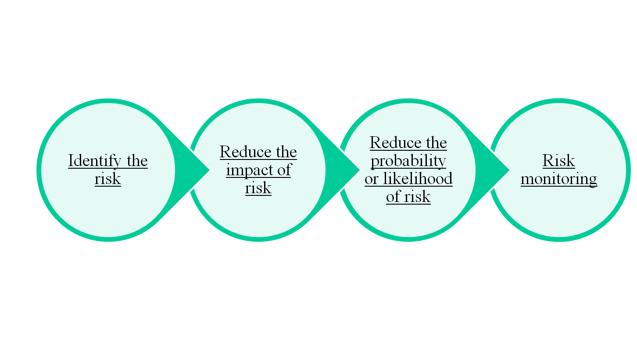
Risk Management

Slide 12


Reactive vs. Proactive Risk Strategies
Reactive risk strategies
  "Don't worry, I'll think of something"
  The majority of software teams and managers rely on this approach.
  Nothing is done about risks until something goes wrong
    The team then flies into action in an attempt to correct the problem rapidly (fire fighting)
  Crisis management is the choice of management techniques.
Proactive risk strategies
  Steps for risk management are followed (see next slide)
  Primary objective is to avoid risk and to have a contingency plan in place to handle unavoidable risks in a controlled and effective manner

Slide 13
Steps for Risk Management
Identify possible risks; recognize what can go wrong
Analyze each risk to estimate the probability that it will occur and the impact (i.e., damage) that it will do if it does occur
Rank the risks by probability and impact
- Impact may be negligible, marginal, critical, and catastrophic.
Develop a contingency plan to manage those risks having high probability and high impact.

Slide 14
Risk Identification

Slide 15
Background
Risk identification is a systematic attempt to specify threats to the project plan
By identifying known and predictable risks, the project manager takes a first step toward avoiding them when possible and controlling them when necessary
Generic risks
  Risks that are a potential threat to every software project
Product-specific risks
  Risks that can be identified only by those a with a clear understanding of the technology, the people, and the environment that is specific to the software that is to be built
  This requires examination of the project plan and the statement of scope
  "What special characteristics of this product may threaten our project plan?"

Slide 16
Risk Item Checklist
Used as one way to identify risks
Focuses on known and predictable risks in specific subcategories (see next slide)
Can be organized in several ways
  A list of characteristics relevant to each risk subcategory
  Questionnaire that leads to an estimate on the impact of each risk
  A list containing a set of risk component and drivers and their probability of occurrence

Slide 17
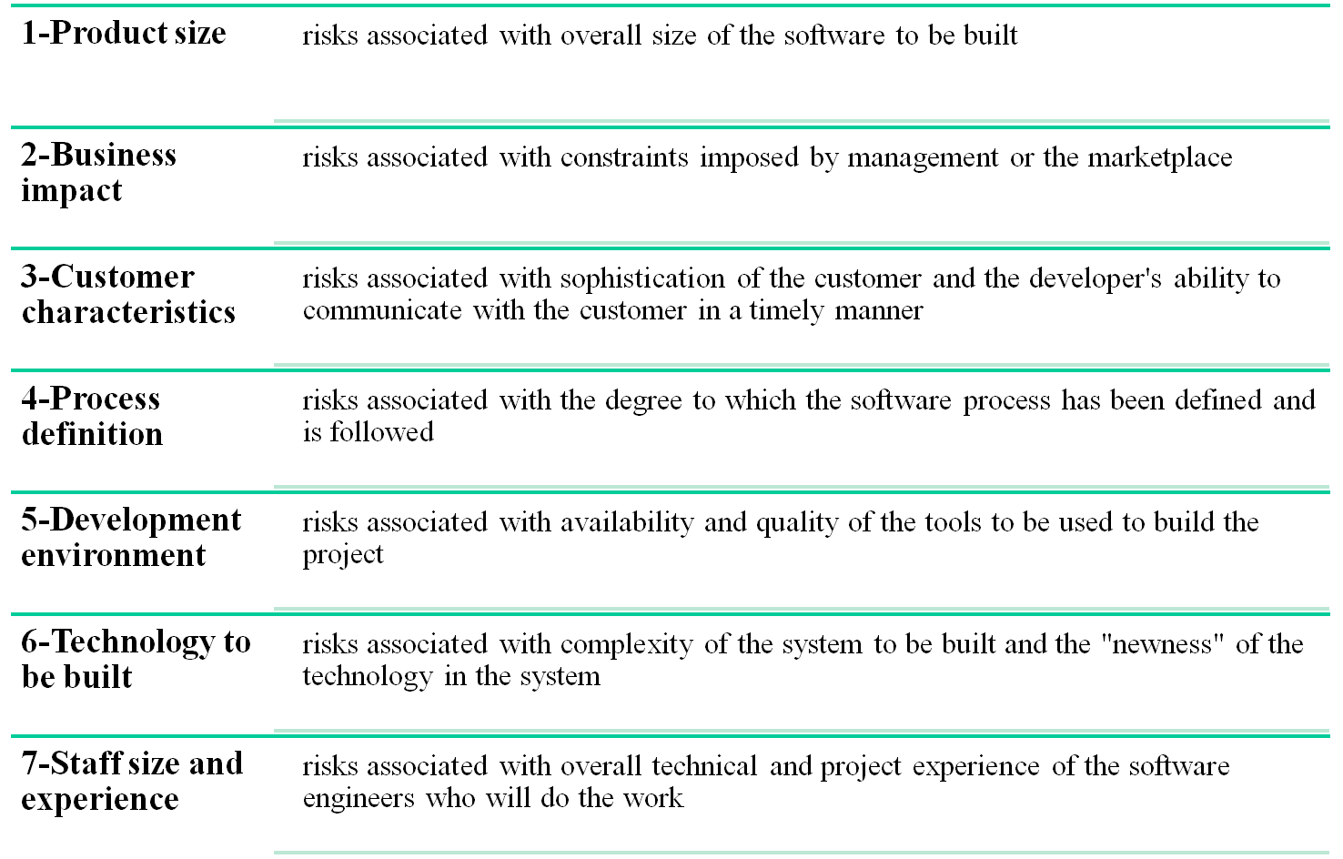
Known and Predictable Risk Categories

Slide 18
Recording Risk Information
Project: Embedded software for XYZ system
Risk type: schedule risk
Priority (1 low ... 5 critical): 4
Risk factor: Project completion will depend on tests which require hardware component under development. Hardware component delivery may be delayed.
Probability: 60 %
Impact: Project completion will be delayed for each day that hardware is unavailable for use in software testing.
Monitoring approach:
Scheduled milestone reviews with hardware group.
Contingency plan:
Modification of testing strategy to accommodate delay using software simulation.
Estimated resources: 6 additional person months beginning 7-1-96.
These courseware materials are to be used in conjunction with Software Engineering: A Practitioner’s Approach, 6/e and are provided with permission by R.S. Pressman & Associates, Inc., copyright © 1996, 2001, 2005

Slide 19
Questionnaire on Project Risk
(Questions are ordered by their relative importance to project success)
Have top software and customer managers formally committed to support the project?
Are end-users enthusiastically committed to the project and the system/product to be built?
Are requirements fully understood by the software engineering team and its customers?
Have customers been involved fully in the definition of requirements?
Do end-users have realistic expectations?
Is the project scope stable?
(More on next slide)
Notes:
The following questions have derived from risk data obtained by surveying experienced
software project managers in different part of the world [KEI98]. The questions
are ordered by their relative importance to the success of a project.

Slide 20
Questionnaire on Project Risk (continued)
Does the software engineering team have the right mix of skills?
Are project requirements stable?
Does the project team have experience with the technology to be implemented?
Is the number of people on the project team adequate to do the job?
Do all customer/user constituencies agree on the importance of the project and on the requirements for the system/product to be built?

Slide 21
Risk Components and Drivers
The project manager identifies the risk drivers that affect the following risk components
  Performance risk - the degree of uncertainty that the product will meet its requirements and be fit for its intended use
  Cost risk - the degree of uncertainty that the project budget will be maintained
  Support risk - the degree of uncertainty that the resultant software will be easy to correct, adapt, and enhance
  Schedule risk - the degree of uncertainty that the project schedule will be maintained and that the product will be delivered on time
The impact of each risk driver on the risk component is divided into one of four impact levels
  Negligible, marginal, critical, and catastrophic
Risk drivers can be assessed as impossible, improbable, probable, and frequent
Notes:
The U.S. Air Force [AFC88] has written a pamphlet that contains excellent guidelines
for software risk identification and abatement. The Air Force approach requires that
the project manager identify the risk drivers that affect software risk components—

Slide 22
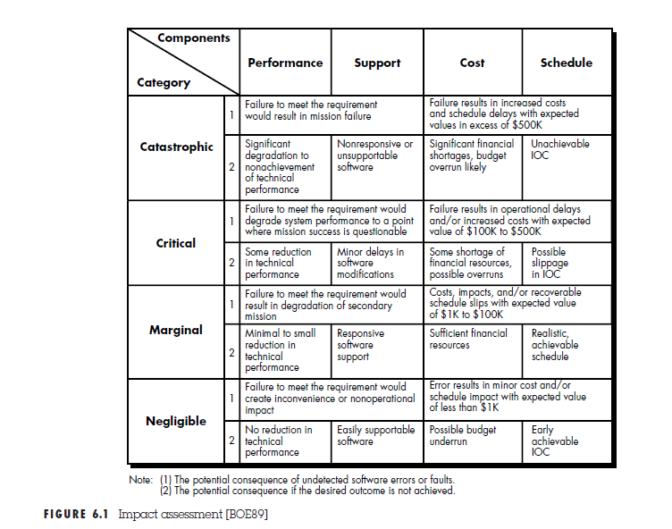
Risk Management
Introduction
Risk identification
Risk projection (estimation)
Risk mitigation, monitoring, and
management
(Source: Pressman, R. Software Engineering: A Practitioner’s Approach. McGraw-Hill, 2005)
Notes:
Initial operational capability (IOC) represents a set of objectives associated with the preparation of the
software for installation/distribution, site preparation prior to installation, and assistance
required by all parties that will use or support the software.

Slide 23
Risk Projection (Estimation)

Slide 24
Background
Risk projection (or estimation) attempts to rate each risk in two ways
  The probability that the risk is real
  The consequence of the problems associated with the risk, should it occur
The project planner, managers, and technical staff perform four risk projection steps (see next slide)
The intent of these steps is to consider risks in a manner that leads to prioritization
By prioritizing risks, the software team can allocate limited resources where they will have the most impact

Slide 25
Risk Projection/Estimation Steps
Establish a scale that reflects the perceived likelihood of a risk (e.g., 1-low, 10-high)
Delineate the consequences of the risk
Estimate the impact of the risk on the project and product
Note the overall accuracy of the risk projection so that there will be no misunderstandings

Slide 26
Contents of a Risk Table
A risk table provides a project manager with a simple technique for risk projection
It consists of five columns
  Risk Summary – short description of the risk
  Risk Category – one of seven risk categories (slide 12)
  Probability – estimation of risk occurrence based on group input
  Impact – (1) catastrophic (2) critical (3) marginal (4) negligible
  RMMM – Pointer to a paragraph in the Risk Mitigation, Monitoring, and Management Plan
Risk Summary | Risk Category | Probability | Impact (1-4) | RMMM
(More on next slide)

Slide 27
Developing a Risk Table
List all risks in the first column (by way of the help of the risk item checklists)
Mark the category of each risk
Estimate the probability of each risk occurring
Assess the impact of each risk based on an averaging of the four risk components to determine an overall impact value (See next slide)
Sort the rows by probability and impact in descending order
Draw a horizontal cutoff line in the table that indicates the risks that will be given further attention

Slide 28
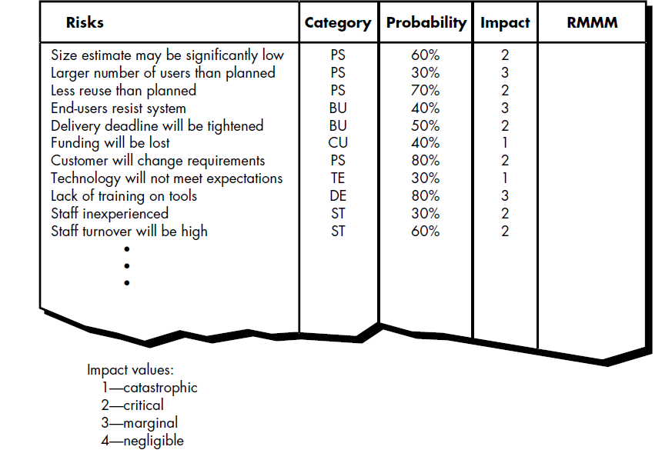


Slide 29
Assessing Risk Impact
Three factors affect the consequences that are likely if a risk does occur
  Its nature – This indicates the problems that are likely if the risk occurs
  Its scope – This combines the severity of the risk (how serious was it) with its overall distribution (how much was affected)
  Its timing – This considers when and for how long the impact will be felt
The overall risk exposure formula is RE = P x C
  P = the probability of occurrence for a risk
  C = the cost to the project should the risk actually occur
Example
  P = 80% probability that 18 of 60 software components will have to be developed
  C = Total cost of developing 18 components is $25,000
  RE = .80 x $25,000 = $20,000

Slide 30
Risk Mitigation, Monitoring, and Management

Slide 31
Background
An effective strategy for dealing with risk must consider three issues
(Note: these are not mutually exclusive)
  Risk mitigation (i.e., avoidance)
  Risk monitoring
  Risk management and contingency planning
Risk mitigation (avoidance) is the primary strategy and is achieved through a plan
  Example: Risk of high staff turnover (see next slide)
(More on next slide)

Slide 32
Background (continued)
Strategy for Reducing Staff Turnover
Meet with current staff to determine causes for turnover (e.g., poor working conditions, low pay, competitive job market)
Mitigate those causes that are under our control before the project starts
Once the project commences, assume turnover will occur and develop techniques to ensure continuity when people leave
Organize project teams so that information about each development activity is widely dispersed
Define documentation standards and establish mechanisms to ensure that documents are developed in a timely manner
Conduct peer reviews of all work (so that more than one person is "up to speed")
Assign a backup staff member for every critical technologist

Slide 33
Background (continued)
During risk monitoring, the project manager monitors factors that may provide an indication of whether a risk is becoming more or less likely
Risk management and contingency planning assume that mitigation efforts have failed and that the risk has become a reality
RMMM steps incur additional project cost
  Large projects may have identified 30 – 40 risks
Risk is not limited to the software project itself
  Risks can occur after the software has been delivered to the user
(More on next slide)

Slide 34
Background (continued)
Software safety and hazard analysis
  These are software quality assurance activities that focus on the identification and assessment of potential hazards that may affect software negatively and cause an entire system to fail
  If hazards can be identified early in the software process, software design features can be specified that will either eliminate or control potential hazards

Slide 35
The RMMM Plan
The RMMM plan may be a part of the software development plan or may be a separate document
Once RMMM has been documented and the project has begun, the risk mitigation, and monitoring steps begin
  Risk mitigation is a problem avoidance activity
  Risk monitoring is a project tracking activity
Risk monitoring has three objectives
  To assess whether predicted risks do, in fact, occur
  To ensure that risk aversion steps defined for the risk are being properly applied
  To collect information that can be used for future risk analysis
The findings from risk monitoring may allow the project manager to ascertain what risks caused which problems throughout the project
Notes:
(Paragraph 5.19.1)

Slide 36
Seven Principles of Risk Management
Maintain a global perspective
View software risks within the context of a system and the business problem that is intended to solve
Take a forward-looking view
Think about risks that may arise in the future; establish contingency plans
Encourage open communication
Encourage all stakeholders and users to point out risks at any time
Integrate risk management
Integrate the consideration of risk into the software process
Emphasize a continuous process of risk management
Modify identified risks as more becomes known and add new risks as better insight is achieved
Develop a shared product vision
A shared vision by all stakeholders facilitates better risk identification and assessment
Encourage teamwork when managing risk
Pool the skills and experience of all stakeholders when conducting risk management activities

Slide 37
Summary
Whenever much is riding on a software project, common sense dictates risk analysis
  Yet, most project managers do it informally and superficially, if at all
However, the time spent in risk management results in
  Less upheaval during the project
  A greater ability to track and control a project
  The confidence that comes with planning for problems before they occur
Risk management can absorb a significant amount of the project planning effort…but the effort is worth it
☺

